Slide 1
Lesson 7:
Review & Exercises
Python Hybrid - Spring 2025

Slide 2
Ask, ask, ask!
If:
you have a Python related problem...
something is not working…
you don’t understand an exercise...
you need help somehow...
Then:
write your question in our Slack channel, maybe someone else had the same issue and can help you
write a colleague on Slack
write a teacher on Slack
note it down and ask next class
...just don’t let it block you!

Slide 3

Review
What you should know

Slide 4
Data types
bool
str
int
List
Dict
Set

Slide 5
bool
True or False
Logical operations
    ==
        >, <, >=, <=
        And 🡪 if 5 >= 2 and len(“redi”) > len(“red”)
        Or
    Not
Boolean assignments
  My_var = (len(“redi”) == 4)
Empty values typically are False: (), [], {}, 0, None
        If my_list:
        ....

Slide 6
Int, float
Used for numbers
Mathematical operations: + - * /
Int() converts object into int
  Int(“1”) 🡪 1
  Int(“redi”) 🡪 Error
  Float supports decimals

Slide 7

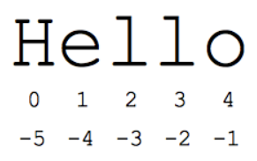
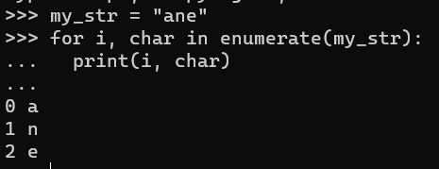
Str
Indexing, what is my_str[0]?
my_str[-1] 🡪 “i”
my_str[0:2] 🡪 “re”
my_str[::-1] reverts the string 🡪 “ider”
String functions:
  “a” in my_str 🡪 False
  “a” not in my_str 🡪 True
  len(my_str) 🡪 4
  my_str.split(“e”) 🡪 ['r', 'di']
  my_str.replace(“a”, “b”) 🡪 “redi”
  My_str.replace(“r”, “0”) 🡪 “0edi”
  My_str + my_second_str
  Python strings are immutable: my_str[0] = “a” 🡪 error
  You can loop through a string in several ways
    For char in my_str
    For i in range(len(my_str)) 🡪 my_str[i]
    For i,char in enumerate(my_str)
  F-string: print(f”I am learning in {my_str}”)

Slide 8
list
Indexing, what is my_list[0]?
my_list[0:2] 🡪 [“redi”, “school”]
my_list[::-1] reverts the list
List functions:
  “a” in my_list 🡪 False
  “2024” in my_list 🡪 True
  “a” not in my_list 🡪 True
  len(my_list) 🡪 4
  My_list.append(“hello”)
  My_list + my_second_list 🡪 same as my_list.extend(my_second_list)
  My_list.insert(0, “first”) 🡪 inserts “first” in the index 0 (first element)
  My_list.remove(“redi”) 🡪 removes first occurrence of “redi”
  My_list.pop() 🡪 removes last element of list. It also works with other indexes
  Python lists are mutable: my_list[0] = “a”
  Convert lists to string like: “ “.join(my_list) 🡪 'redi school 2024 python’
  Convert lists to string like: “,“.join(my_list) 🡪 'redi,school,2024,python'
  You can loop through a list in several ways
    For elem in my_list
    For i in range(len(my_list))
    For i, elem in enumerate(my_list)
list(“hello world”) to convert different objects onto lists
Other resources: https://www.analyticsvidhya.com/blog/2021/07/all-the-basics-to-begin-with-python-lists/

Slide 9
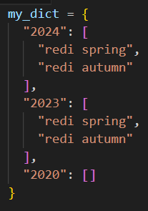
dict
Access values with keys: my_dict[“2024”] 🡪 [“redi spring”, “redi autumn”]
Dictionary functions:
  “2024” in my_dict 🡪 True
  Len(my_dict) 🡪 returns how many keys 🡪 3
  My_dict.keys() 🡪 [“2020”, “2023”, “2024”]
  My_dict.values()
  My_dict.items() 🡪 returns tuples of keys and values
  For key, value in my_dict.items():
  My_dict[“2023”] = [] 🡪 assign values to new key
  Del my_dict[“2020”]

Slide 10
What you should know part 2
Loops (for, while, continue, break)
Conditions (if, elif, else)
Functions (dealing with input, output)
Error handling (try, except)
Debugging

Slide 11
Exercises
From Lesson 7 (strings, lists and dictionaries):
  exercise_1
  exercise_2
New for practicing
  lists.py
  dicts.py
  More dict exercises Python Dictionary Exercise with Solutions
File exercises
  files.py
Online challenges (for the second part of the class)
  Richest customer wealth https://leetcode.com/problems/richest-customer-wealth/
  Single number https://leetcode.com/problems/single-number/

Slide 12
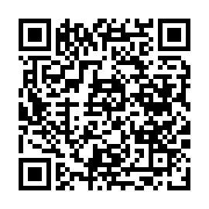
Before you go…
Please take 2 minutes to give us feedback on today’s lesson.
This feedback is anonymous and only seen by the DCP team!
Scan the QR code or go to: https://redischool.typeform.com/lessonfeedback

